Slide 1

TensorFlow 2.0
PRACTICAL

Slide 2

PROJECT #9 OVERVIEW

Slide 3

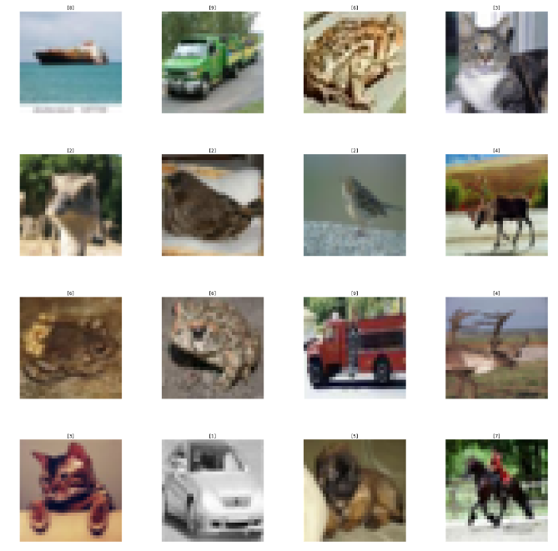
PROJECT #9: CIFAR-10 CLASSIFICATION
CIFAR-10 is a dataset that consists of several images divided into the following 10 classes:
Airplanes, Cars, Birds, Cats, Deer, Dogs, Frogs, Horses, Ships, Trucks
The dataset stands for the Canadian Institute For Advanced Research (CIFAR)
CIFAR-10 is widely used for machine learning and computer vision applications.
The dataset consists of 60,000 32x32 color images, 6,000 images of each class.
Images have low resolution (32x32).
Data Source: https://www.cs.toronto.edu/~kriz/cifar.html
TensorFlow 2.0 PRACTICAL

Slide 4
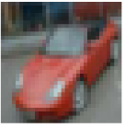
PROJECT #9: CIFAR-10 CLASSIFICATION
The dataset consists of 60,000 32x32 color images, 6,000 images of each class.
TARGET CLASSES
Airplanes
Cars
Birds
Cats
Deer
Dogs
Frogs
Horses
Ships
Trucks
INPUT IMAGE
CLASSIFIER
32
CIFAR-10 Dataset consists of 60,000 images
50,000 training
10,000 testing
Images are 32x32 pixels (colored)
32
TensorFlow 2.0 PRACTICAL

